Slide 1
Classical Encryption
Techniques
4CS401
M. K. Chavan,
Asst. Professor, CSE Department,
Walchand College of Engineering, Sangli

Slide 2
Classical encryption techniques
As opposed to modern cryptography
Goals:
  to introduce basic concepts & terminology of encryption
  to prepare us for studying modern cryptography

Slide 3
Basic terminology
Plaintext: original message to be encrypted
Ciphertext: the encrypted message
Enciphering or encryption: the process of converting plaintext into ciphertext
Encryption algorithm: performs encryption
  Two inputs: a plaintext and a secret key

Slide 4
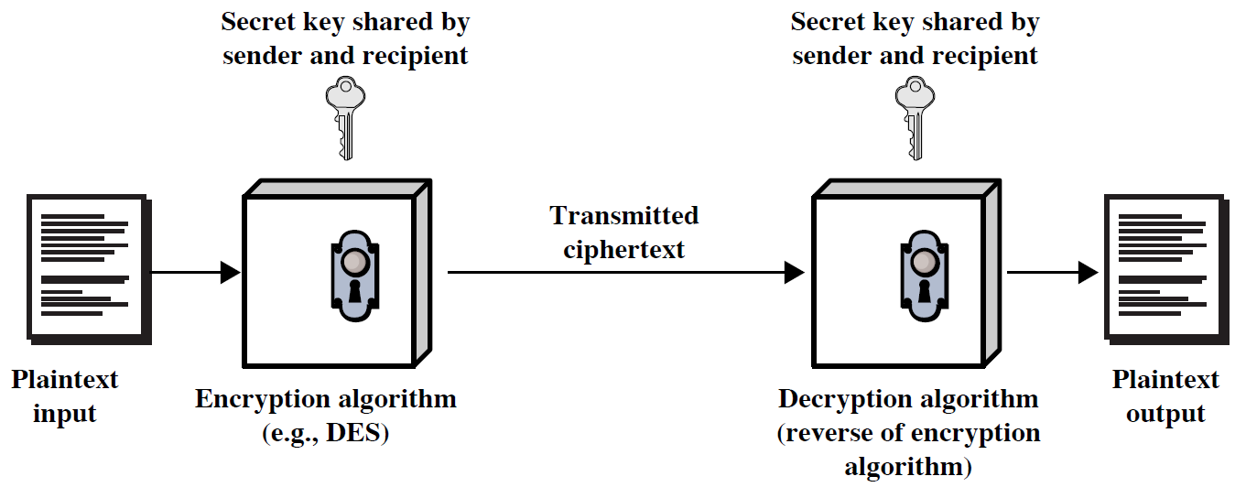
Symmetric Cipher Model

Slide 5
Deciphering or decryption: recovering plaintext from ciphertext
Decryption algorithm: performs decryption
  Two inputs: ciphertext and secret key
Secret key: same key used for encryption and decryption
  Also referred to as a symmetric key

Slide 6
Cipher or cryptographic system : a scheme for encryption and decryption
Cryptography: science of studying ciphers
Cryptanalysis: science of studying attacks against cryptographic systems
Cryptology: cryptography + cryptanalysis

Slide 7
Ciphers
Symmetric cipher: same key used for encryption and decryption
  Block cipher: encrypts a block of plaintext at a time (typically 64 or 128 bits)
  Stream cipher: encrypts data one bit or one byte at a time
Asymmetric cipher: different keys used for encryption and decryption

Slide 8
Symmetric Encryption
or conventional / secret-key / single-key
sender and recipient share a common key
all classical encryption algorithms are symmetric
The only type of ciphers prior to the invention of asymmetric-key ciphers in 1970’s
by far most widely used

Slide 9
Symmetric Encryption
Mathematically:
  Y = E_{K}(X) or Y = E(K, X)
  X = D_{K}(Y) or X = D(K, Y)
X = plaintext
Y = ciphertext
K = secret key
E = encryption algorithm
D = decryption algorithm
Both E and D are known to public

Slide 10
Cryptanalysis
Objective: to recover the plaintext of a ciphertext or, more typically, to recover the secret key.
Two general approaches:
  brute-force attack
  non-brute-force attack (cryptanalytic attack)

Slide 11
Brute-Force Attack
Try every key to decipher the ciphertext.
On average, need to try half of all possible keys
Time needed proportional to size of key space
Key Size (bits) | Number of Alternative Keys | Time required at 1 decryption/µs | Time required at 10⁶ decryptions/µs
32 | 2³² = 4.3 × 10⁹ | 2³¹ µs = 35.8 minutes | 2.15 milliseconds
56 | 2⁵⁶ = 7.2 × 10¹⁶ | 2⁵⁵ µs = 1142 years | 10.01 hours
128 | 2¹²⁸ = 3.4 × 10³⁸ | 2¹²⁷ µs = 5.4 × 10²⁴ years | 5.4 × 10¹⁸ years
168 | 2¹⁶⁸ = 3.7 × 10⁵⁰ | 2¹⁶⁷ µs = 5.9 × 10³⁶ years | 5.9 × 10³⁰ years
26 characters (permutation) | 26! = 4 × 10²⁶ | 2 × 10²⁶ µs = 6.4 × 10¹² years | 6.4 × 10⁶ years

Slide 12
Classical Cryptography
Sender, receiver share common key
  Keys may be the same, or trivial to derive from one another
  Sometimes called symmetric cryptography
Two basic types
  Transposition ciphers
  Substitution ciphers
  Combinations are called product ciphers

Slide 13
Classical Ciphers
Plaintext is viewed as a sequence of elements (e.g., bits or characters)
Substitution cipher: replacing each element of the plaintext with another element.
Transposition (or permutation) cipher: rearranging the order of the elements of the plaintext.
Product cipher: using multiple stages of substitutions and transpositions

Slide 14
Transposition Cipher
Rearrange letters in plaintext to produce ciphertext
Example (Rail-Fence Cipher or 2-columnar transposition)
  Plaintext is HELLO WORLD
  HE
  LL
  OW
  OR
  LD
  Ciphertext is HLOOL ELWRD

Slide 15
Transposition Cipher
Generalize to n-columnar transpositions
Example 3-columnar
  HEL
  LOW
  ORL
  DXX
  HLODEORXLWLX

Slide 16
Caesar Cipher
Earliest known substitution cipher
Invented by Julius Caesar
Each letter is replaced by the letter three positions further down the alphabet.
  Plain: a b c d e f g h i j k l m n o p q r s t u v w x y z
  Cipher: D E F G H I J K L M N O P Q R S T U V W X Y Z A B C
Example: ohio state → RKLR VWDWH

Slide 17
Caesar Cipher
Mathematically, map letters to numbers:
  a, b, c, ..., x, y, z
  0, 1, 2, ..., 23, 24, 25
Then the general Caesar cipher is:
  c = E_{K}(p) = (p + k) mod 26
  p = D_{K}(c) = (c – k) mod 26
Can be generalized with any alphabet.

Slide 18
Cryptanalysis of Caesar Cipher
Key space: {0, 1, ..., 25}
Vulnerable to brute-force attacks.
E.g., break ciphertext “DWWDFN“

Slide 19
Monoalphabetic Substitution Cipher
Shuffle the letters and map each plaintext letter to a different random ciphertext letter:
  Plain letters: abcdefghijklmnopqrstuvwxyz
  Cipher letters: DKVQFIBJWPESCXHTMYAUOLRGZN
  Plaintext: ifwewishtoreplaceletters
  Ciphertext: WIRFRWAJUHYFTSDVFSFUUFYA

Slide 20
Monoalphabetic Cipher Security
With so many keys, it is secure against brute-force attacks.
But not secure against some cryptanalytic attacks.
Problem is language characteristics.

Slide 21
Language Statistics and Cryptanalysis
Human languages are not random.
Letters are not equally frequently used.
In English, E is by far the most common letter, followed by T, R, N, I, O, A, S.
Other letters like Z, J, K, Q, X are fairly rare.
There are tables of single, double & triple letter frequencies for various languages

Slide 22
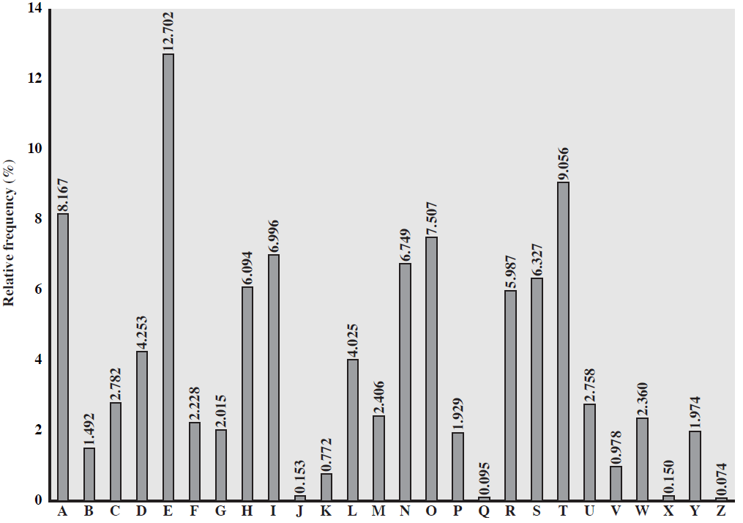
English Letter Frequencies

Slide 23
Statistics for double & triple letters
In decreasing order of frequency
Double letters:
th he an in er re es on, …
Triple letters:
the and ent ion tio for nde, …

Slide 24
Use in Cryptanalysis
Key concept: monoalphabetic substitution does not change relative letter frequencies
To attack, we
  calculate letter frequencies for ciphertext
  compare this distribution against the known one

Slide 25
Example Cryptanalysis
Given ciphertext:
  UZQSOVUOHXMOPVGPOZPEVSGZWSZOPFPESXUDBMETSXAIZ
  VUEPHZHMDZSHZOWSFPAPPDTSVPQUZWYMXUZUHSX
  EPYEPOPDZSZUFPOMBZWPFUPZHMDJUDTMOHMQ
Count relative letter frequencies (see next page)
Guess {P, Z} = {e, t}
Of double letters, ZW has highest frequency, so guess ZW = th and hence ZWP = the
Proceeding with trial and error finally get:
  it was disclosed yesterday that several informal but
  direct contacts have been made with political
  representatives of the viet cong in moscow

Slide 26
Letter frequencies in ciphertext
P 13.33 | H 5.83 | F 3.33 | B 1.67 | C 0.00
Z 11.67 | D 5.00 | W 3.33 | G 1.67 | K 0.00
S 8.33 | E 5.00 | Q 2.50 | Y 1.67 | L 0.00
U 8.33 | V 4.17 | T 2.50 | I 0.83 | N 0.00
O 7.50 | X 4.17 | A 1.67 | J 0.83 | R 0.00
M 6.67

Slide 27
Playfair Cipher
Not even the large number of keys in a monoalphabetic cipher provides security.
One approach to improving security is to encrypt multiple letters at a time.
The Playfair Cipher is the best known such cipher.
Invented by Charles Wheatstone in 1854, but named after his friend Baron Playfair.

Slide 28
Playfair Key Matrix
Use a 5 x 5 matrix.
Fill in letters of the key (w/o duplicates).
Fill the rest of matrix with other letters.
E.g., key = MONARCHY.
M | O | N | A | R
C | H | Y | B | D
E | F | G | I/J | K
L | P | Q | S | T
U | V | W | X | Z

Slide 29
Encrypting and Decrypting
Plaintext is encrypted two letters at a time.
  If a pair is a repeated letter, insert filler like 'X’.
  If both letters fall in the same row, replace each with the letter to its right (circularly).
  If both letters fall in the same column, replace each with the the letter below it (circularly).
  Otherwise, each letter is replaced by the letter in the same row but in the column of the other letter of the pair.

Slide 30
Polyalphabetic Substitution Ciphers
A sequence of monoalphabetic ciphers (M₁, M₂, M₃, ..., M_{k}) is used in turn to encrypt letters.
A key determines which sequence of ciphers to use.
Each plaintext letter has multiple corresponding ciphertext letters.
This makes cryptanalysis harder since the letter frequency distribution will be flatter.

Slide 31
Vigenère Cipher
Simplest polyalphabetic substitution cipher
Consider the set of all Caesar ciphers:
{ C_{a}, C_{b}, C_{c}, ..., C_{z} }
Key: e.g. security
Encrypt each letter using C_{s}, C_{e}, C_{c}, C_{u}, C_{r}, C_{i}, C_{t}, C_{y} in turn.
Repeat from start after C_{y}.
Decryption simply works in reverse.

Slide 32
Example of Vigenère Cipher
Keyword: deceptive
  key: deceptivedeceptivedeceptive
  plaintext: wearediscoveredsaveyourself
  ciphertext: ZICVTWQNGRZGVTWAVZHCQYGLMGJ
C=(p+k) mod 26

Slide 33
Transposition Ciphers
Also called permutation ciphers.
Shuffle the plaintext, without altering the actual letters used.
Example: Row Transposition Ciphers

Slide 34
Rail Fence cipher
write message letters out diagonally over a number of rows
then read off cipher row by row
eg. write message out as:
  m e m a t r h t g p r y
  e t e f e t e o a a t
giving ciphertext
  MEMATRHTGPRYETEFETEOAAT
Notes:
The simplest such cipher is the rail fence technique, in which the plaintext is written down as a sequence of diagonals and then read off as a sequence of rows.
The example message is: "meet me after the toga party" with a rail fence of depth 2.
This sort of thing would be trivial to cryptanalyze.

Slide 35
Row Transposition Ciphers
Plaintext is written row by row in a rectangle.
Ciphertext: write out the columns in an order specified by a key.
  Key: 4 3 1 2 5 6 7
  Plaintext:
  Ciphertext: TTNAAPTMTSUOAODWCOIXKNLYPETZ
a | t | t | a | c | k | p
o | s | t | p | o | n | e
d | u | n | t | i | l | t
w | o | a | m | x | y | z

Slide 36
Product Ciphers
Uses a sequence of substitutions and transpositions
  Harder to break than just substitutions or transpositions
This is a bridge from classical to modern ciphers.

Slide 37
Unconditional & Computational Security
A cipher is unconditionally secure if it is secure no matter how much resources (time, space) the attacker has.
A cipher is computationally secure if the best algorithm for breaking it will require so much resources (e.g., 1000 years) that practically the cryptosystem is secure.
All the ciphers we have examined are not unconditionally secure.

Slide 38
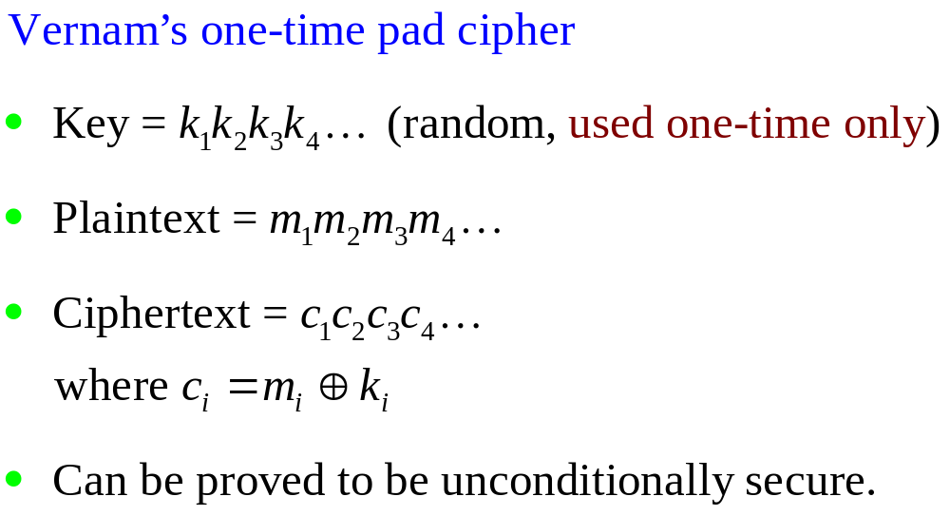
An unconditionally Secure Cipher

Slide 39
Summary
Have considered:
  classical cipher techniques and terminology
  monoalphabetic substitution ciphers
  cryptanalysis using letter frequencies
  Playfair cipher
  polyalphabetic ciphers
  transposition ciphers
  product ciphers

